Slide 1
Analyzing Running Time

Slide 2
Sorting Algorithms
The first one, known as insertion sort,
takes time roughly equal to c1.n² to sort n items, where c1 is a constant that does not depend on n.
The insertion sort algorithm takes time roughly proportional to n².
The second one, is the merge sort.
Takes time roughly equal to c2.n.lg n, where lgn stands for log₂n and c2 is another constant that also does not depend on n.

Slide 3
Insertion sort typically has a smaller constant factor than merge sort, so that c1 < c2.
The insertion sort’s running time is c1n . n
The merge sort’s running time is c2n . lg n
The insertion sort has a factor of n in its running time.
The merge sort has a factor of lgn, which is much smaller.

Slide 4
Examples:
When n = 1000, lgn is approximately 10.
When n equals one million, lgn is approximately only 20.
Although insertion sort usually runs faster than merge sort for small input sizes, once the input size n becomes large enough, merge sort’s advantage of lgn vs. n will more than compensate for the difference in constant factors.

Slide 5
Scenario
A faster computer (computer A) running insertion sort against a slower computer (computer B) running merge sort.
They each must sort an array of 10 million numbers.
Computer A executes 10 billion instructions per second
Computer B executes only 10 million instructions per second
Computer A is 1000 times faster than computer B in raw computing power.

Slide 6
For computer A: The world’s craftiest programmer codes insertion sort in machine language, and the resulting code requires 2n² instructions to sort n numbers.
For computer B: An average programmer implements merge sort, using a high-level language with an inefficient compiler, with the resulting code taking 50nlgn instructions.

Slide 7
To sort 10 million numbers, computer A takes:
while computer B takes:

Slide 8
Insertion Sort in Details
Is an efficient algorithm for sorting a small number of elements.

Slide 9
INSERTION-SORT Procedure
Takes as a parameter an array A[1..n] containing a sequence of length n that is to be sorted.
The algorithm sorts the input numbers in place: it rearranges the numbers within the array A, with at most a constant number of them stored outside the array at any time.
The input array A contains the sorted output sequence when the INSERTION-SORT procedure is finished.

Slide 10
(a)–(e) The iterations of the for loop of lines 1–8.
In each iteration, the black rectangle holds the key taken from A[j], which is compared with the values in shaded rectangles to its left in the test of
line 5.
Shaded arrows show array values moved one position to the right in line 6, and black arrows indicate where the key moves to in line 8.
(f) The final sorted array.

Slide 11
The body of the for loop that begins on line 1 consists of lines 2–8.
The body of the while loop that begins on line 5 contains lines 6–7 but not line 8.
The indentation style applies to if-else statements as well.
The keyword downto is used when a for loop decrements its loop counter.
When the loop counter changes by an amount greater than 1, the amount of change follows the optional keyword by.
The symbol “//” indicates that the remainder of the line is a comment.

Slide 12
Analyzing Algorithms
Analyzing an algorithm: predicting the resources that the algorithm requires.
Resources such as memory, communication bandwidth, or computer hardware are of primary concern, but most often it is computational time that we want to measure.
Generally, by analyzing several candidate algorithms for a problem, we can identify a most efficient one.

Slide 13
RAM model
In the RAM model, instructions are executed one after another, with no concurrent operations.
The RAM model contains instructions commonly found in real computers:
arithmetic (such as add, subtract, multiply, divide, remainder, floor, ceiling).
data movement (load, store, copy),
control (conditional and unconditional branch, subroutine call and return).
Each such instruction takes a constant amount of time.

Slide 14
Analysis of Insertion Sort
In general, the time taken by an algorithm grows with the size of the input.
INSERTIONSORT can take different amounts of time to sort two input sequences of the same size depending on how nearly sorted they already are.
The best notion for input size depends on the problem being studied:
Sorting or computing discrete Fourier transforms: the measure is the number of items in the input.

Slide 15
For multiplying two integers: the measure of input size is the total number of bits needed to represent the input in ordinary binary notation.
If the input to an algorithm is a graph, the input size can be described by the numbers of vertices and edges in the graph.

Slide 16
The running time of an algorithm on a particular input is:
“ the number of primitive operations or “steps” executed before termination, where each step requires a specific amount of time.”
One line may take a different amount of time than another line.
We assume that each execution of the i^{th} line takes time c_{i}, where c_{i} is a constant.

Slide 17
We start by presenting the INSERTION-SORT procedure with:
The time “cost” of each statement.
The number of times each statement is executed.
For each j = 2,3, …,n, where n = A:length:
Let t_{j} denote the number of times the while loop test in line 5 is executed for that value of j.
When a for or while loop exits in the usual way (i.e., due to the test in the loop header), the test is executed one time more than the loop body.
We assume that comments are not executable statements, and so they take no time.

Slide 19
The running time of the algorithm = the sum of running times for each statement executed.
A statement that takes c_{i} steps to execute and executes n times will contribute c_{i} . n to the total running time.
T (n) the running time of INSERTION-SORT on an input of n values is:

Slide 20
Even for inputs of a given size, an algorithm’s running time may depend on which input of that size is given.
In INSERTION-SORT, the best case occurs if the array is already sorted.
For each j = 2,3, . . . . ,n, we then find that A[i]<= key in line 5 when i has its initial value of (j-1).

Slide 21
Thus t_{j} = 1 for j = 2,3, . . . . ,n, the best-case running time is:
We can express this running time as : an+b for constants a and b that depend on the statement costs c_{i}; it is thus a linear function of n.

Slide 22
If the array is in reverse sorted order (decreasing order), the worst case results.
The worst-case running time: is the longest running time for any input of size n.
We must compare each element A[j] with each element in the entire sorted subarray A[1 . . J-1], and so t_{j} = j for j = 2,3, . . . ,n.
Since,

Slide 23
In the worst case, the running time of INSERTION-SORT is:

Slide 24
For the insertion-sort the worst-case running time is:
a.n² + b.n + c
for constants a, b, and c that again depend on the statement costs c_{i} ; it is thus a quadratic function of n.

Slide 25
Analysis of the worst-case running time of an algorithm:
Gives us an upper bound on the running time for any input. Knowing it provides a guarantee that the algorithm will never take any longer.
For some algorithms, the worst case occurs fairly often. For example, in searching a database for a particular piece of information (info not present).

Slide 26
The “average case” is often roughly as bad as the worst case.
Suppose that we randomly choose n numbers and apply insertion sort.
How long does it take to determine where in subarray A[1 . . . J-1] to insert element A[j] ?
On average, half the elements in A[1 . . . J-1] are less than A[j] , and half the elements are greater.
On average means we check half of the subarray A[1 . . . J-1] , and so t_{j} is about j/2.
The resulting average-case running time turns out to be a quadratic function of the input size, just like the worst-case running time.

Slide 27
Order of Growth (rate of growth)
For the insertion-sort ,
the worst-case running time as a quadratic function of n =
a.n² + b.n + c
for constants a, b, and c that again depend on the statement costs c_{i} .
We consider only the leading term of a formula (a.n²), since the lower-order terms are relatively insignificant for large values of n.
We also ignore the leading term’s constant coefficient, since constant factors are less significant than the rate of growth in determining computational efficiency for large inputs.

Slide 28
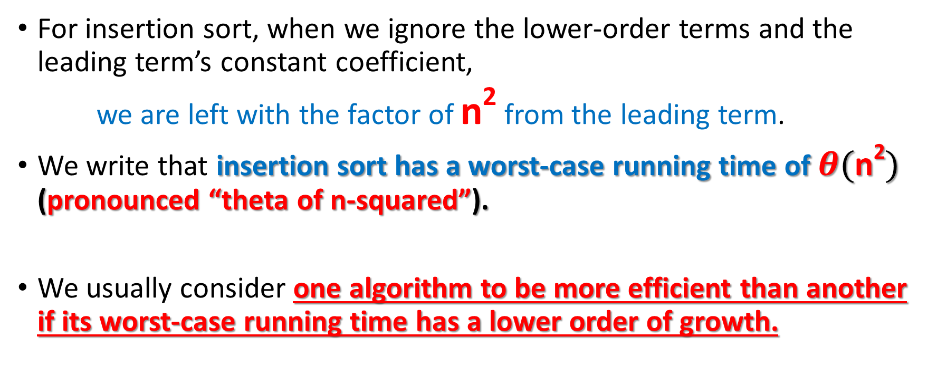
For insertion sort, when we ignore the lower-order terms and the leading term’s constant coefficient,
we are left with the factor of n² from the leading term.
We write that insertion sort has a worst-case running time of $θ(\text{n}\text{2})$ (pronounced “theta of n-squared”).
We usually consider one algorithm to be more efficient than another if its worst-case running time has a lower order of growth.

Slide 29
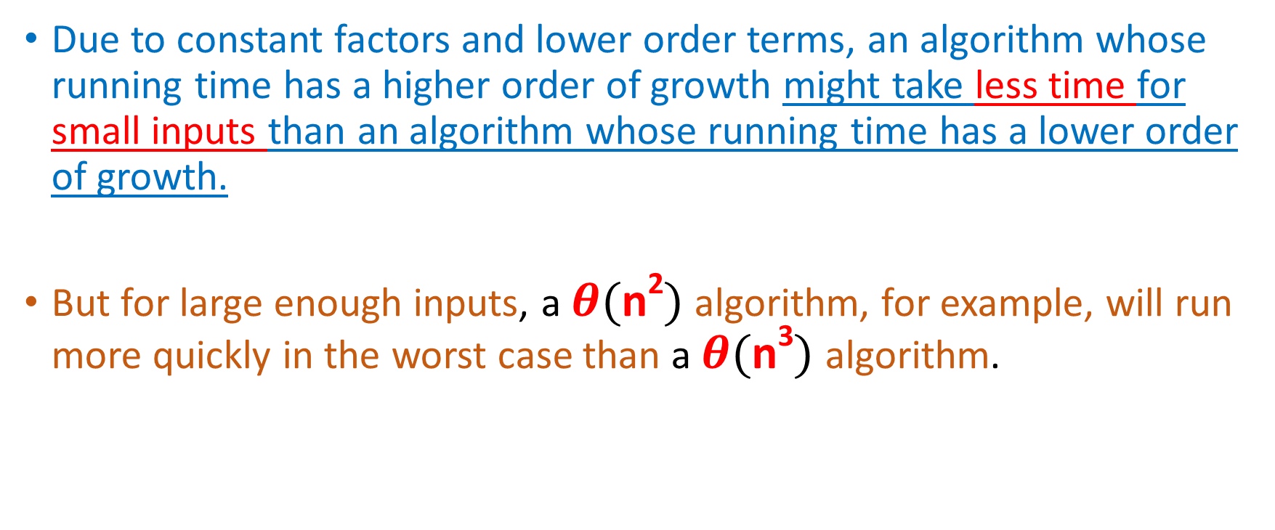
Due to constant factors and lower order terms, an algorithm whose running time has a higher order of growth might take less time for small inputs than an algorithm whose running time has a lower order of growth.
But for large enough inputs, a $θ(\text{n}\text{2})$ algorithm, for example, will run more quickly in the worst case than a $θ(\text{n}\text{3})$ algorithm.

Slide 30
Designing Algorithms
For insertion sort, we used an incremental approach: having sorted the subarray A[1 . . . J-1] , we inserted the single element A[J] into its proper place, yielding the sorted subarray A[1 . . . J].
We’ll use divide and conquer approach to design a sorting algorithm whose worst-case running time is much less than that of insertion sort.
One advantage of divide-and-conquer algorithms is that their running times are often easily determined using techniques that we will see in Chapter 4.

Slide 31
The divide-and-conquer approach
Many useful algorithms are recursive in structure: to solve a given problem, they call themselves recursively one or more times to deal with closely related subproblems.
These algorithms typically follow a divide-and-conquer approach:
They break the problem into several subproblems that are similar to the original problem but smaller in size,
Solve the subproblems recursively,
And then combine these solutions to create a solution to the original problem.

Slide 32
The divide-and-conquer paradigm involves three steps at each level of the recursion:
Divide the problem into a number of subproblems that are smaller instances of the same problem.
Conquer the subproblems by solving them recursively. If the subproblem sizes are small enough, however, just solve the subproblems in a straightforward manner.
Combine the solutions of the subproblems into the solution for the original problem.

Slide 33
Merge Sort Algorithm
Divide: Divide the n-element sequence to be sorted into two subsequences of n/2 elements each.
Conquer: Sort the two subsequences recursively using merge sort.
Combine: Merge the two sorted subsequences to produce the sorted answer.
The recursion “bottoms out” when the sequence to be sorted has length 1, in which case there is no work to be done.

Slide 35
To sort A[p . .r]:
Divide by splitting into two subarrays A[p . .q]. and A[q+1 . .r],
where q is the halfway point of A[p . .r].
Conquer by recursively sorting the two subarrays
A[p . .q]. and A[q+1 . .r].
Combine by merging the two sorted subarrays A[p . .q]. and A[q+1 . .r] to produce a single sorted subarray A[p . .r]. To accomplish this step, we’ll define a procedure MERGE(A, p, q, r).

Slide 36
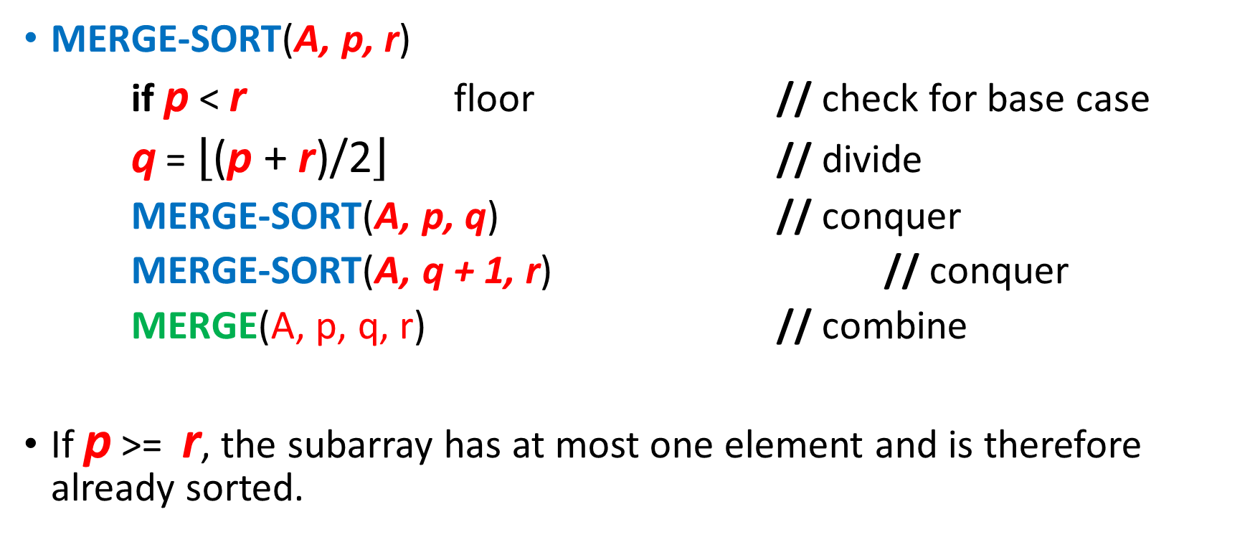
MERGE-SORT(A, p, r)
if p < r floor // check for base case
q = $\left\lfloor \text{(}\text{p}\text{ + }\text{r}\text{)/2}\right\rfloor$ // divide
MERGE-SORT(A, p, q) // conquer
MERGE-SORT(A, q + 1, r) // conquer
MERGE(A, p, q, r) // combine
If p >= r, the subarray has at most one element and is therefore already sorted.

Slide 38
[Here, at the next-to-last level of recursion, some of the subproblems have only 1
element. The recursion bottoms out on these single-element subproblems.]

Slide 39
Merging
The MERGE procedure:
Input: Array A and indices p, q, and r such that
p <= q < r.
Subarray A[p . .q] is sorted and subarray A[q+1 . .r] is sorted. By the restrictions on p, q, r, neither subarray is empty.
Output: The two subarrays are merged into a single sorted subarray in A[p . .r] .

Slide 40
What is n?
Until now, n has stood for the size of the original problem.
But now we’re using it as the size of a subproblem.
We will use this technique when we analyze recursive algorithms.
Although we may denote the original problem size by n, in general n will be the size of a given subproblem.

Slide 44

The MERGE procedure takes time $θ(\text{n})$ , where n = r - p + 1 is the total number of elements being merged.
Each of lines 1–3 and 8–11 takes constant time, the for loops of lines 4–7 take $θ\left(n1+n2\right)=θ(\text{n})$, and there are $n$ iterations of the for loop of lines 12–17, each of which takes constant time.

Slide 45
Analyzing divide-and-conquer algorithms
When an algorithm contains a recursive call to itself, we can often describe its running time by a recurrence equation or recurrence.
The recurrence, describes the overall running time on a problem of size n in terms of the running time on smaller inputs.
A recurrence for the running time of a divide-and-conquer algorithm falls out from the three steps of the basic paradigm.

Slide 46
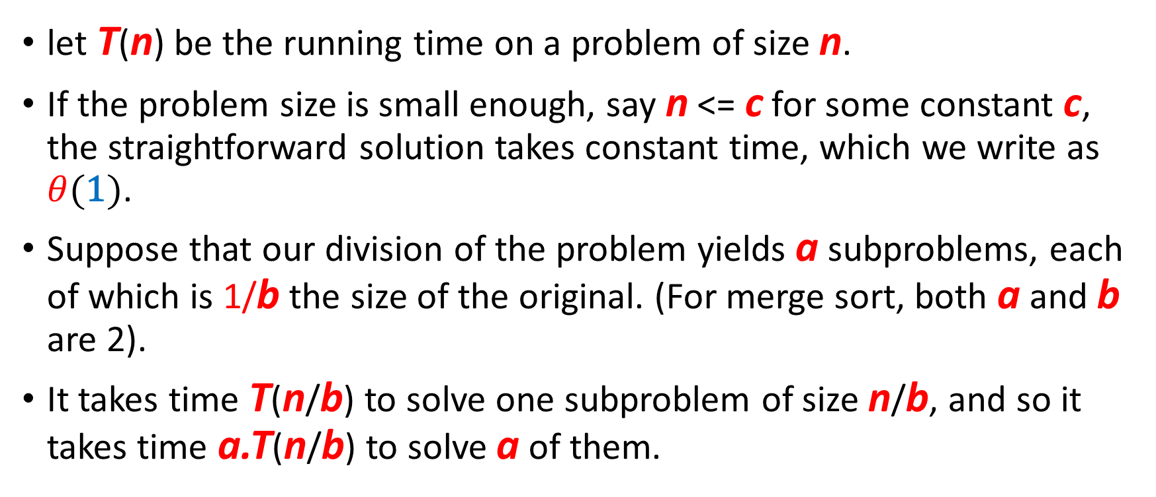
let T(n) be the running time on a problem of size n.
If the problem size is small enough, say n <= c for some constant c, the straightforward solution takes constant time, which we write as $θ(\text{1})$.
Suppose that our division of the problem yields a subproblems, each of which is 1/b the size of the original. (For merge sort, both a and b are 2).
It takes time T(n/b) to solve one subproblem of size n/b, and so it takes time a.T(n/b) to solve a of them.

Slide 47
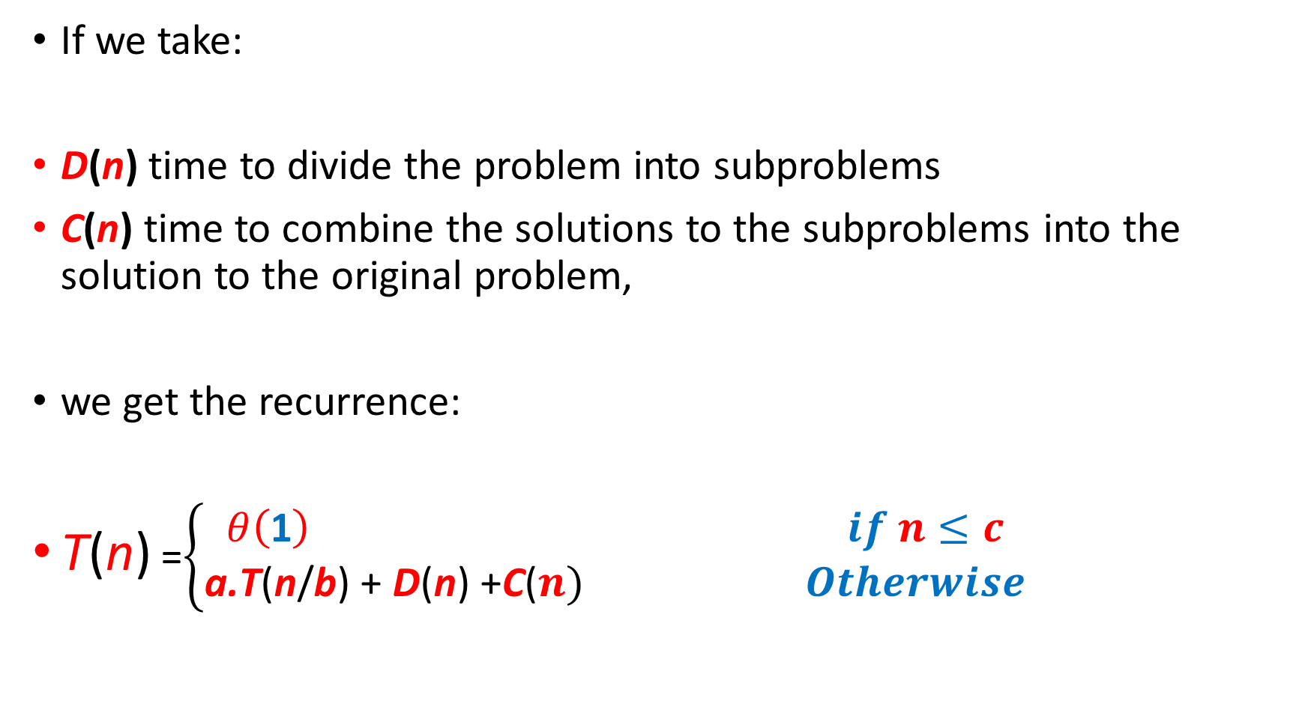
If we take:
D(n) time to divide the problem into subproblems
C(n) time to combine the solutions to the subproblems into the solution to the original problem,
we get the recurrence:
T(n) =$\left\{\begin{aligned}θ\left(\text{1}\right) if n≤c \\ \text{a}\text{.}\text{T}\text{(}\text{n}\text{/}\text{b}\text{)}\text{ + }\text{D}\text{(}\text{n}\text{) +}\text{C}\text{(}n) Otherwise\end{aligned}\right.$

Slide 48
Analysis of merge sort
The pseudocode for MERGE-SORT works correctly when the number of elements is odd or even.
For the recurrence-based analysis, we assume that the original problem size is a power of 2.
Each divide step then yields two subsequences of size exactly n/2.
Merge sort on just one element takes constant time.

Slide 49
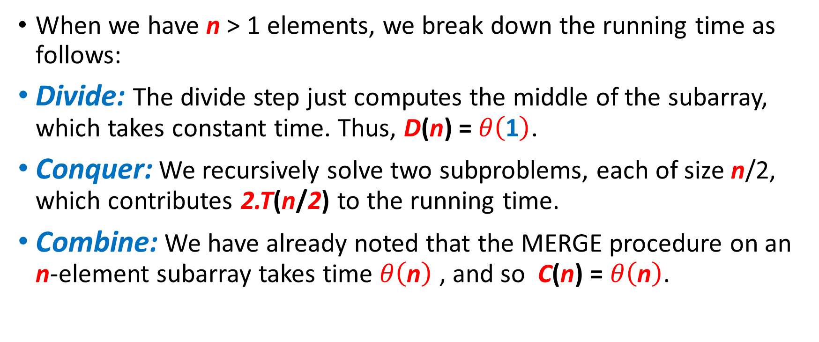
Worst case analysis
When we have n > 1 elements, we break down the running time as follows:
Divide: The divide step just computes the middle of the subarray, which takes constant time. Thus, D(n) = $θ\left(\text{1}\right)$.
Conquer: We recursively solve two subproblems, each of size n/2, which contributes 2.T(n/2) to the running time.
Combine: We have already noted that the MERGE procedure on an n-element subarray takes time $θ\left(\text{n}\right)$ , and so C(n) = $θ\left(\text{n}\right)$.

Slide 50
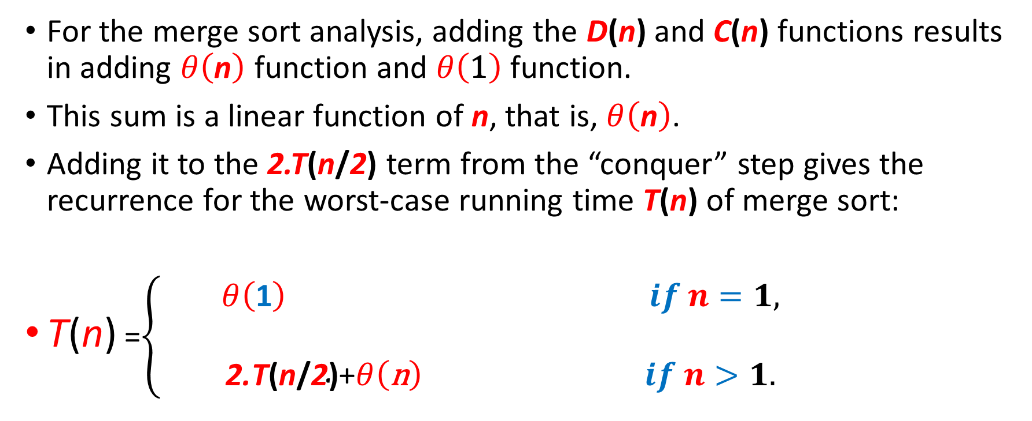
For the merge sort analysis, adding the D(n) and C(n) functions results in adding $θ\left(\text{n}\right)$ function and $θ\left(\text{1}\right)$ function.
This sum is a linear function of n, that is, $θ\left(\text{n}\right)$.
Adding it to the 2.T(n/2) term from the “conquer” step gives the recurrence for the worst-case running time T(n) of merge sort:
T(n) =$\left\{\begin{aligned}θ\left(\text{1}\right) if n=1, \\ \\ \text{2.}\text{T}\text{(}\text{n}\text{/}\text{2}\text{)}\text{+}θ\left(\text{n}\right) if n>1.\end{aligned}\right.$
(2.1)

Slide 51
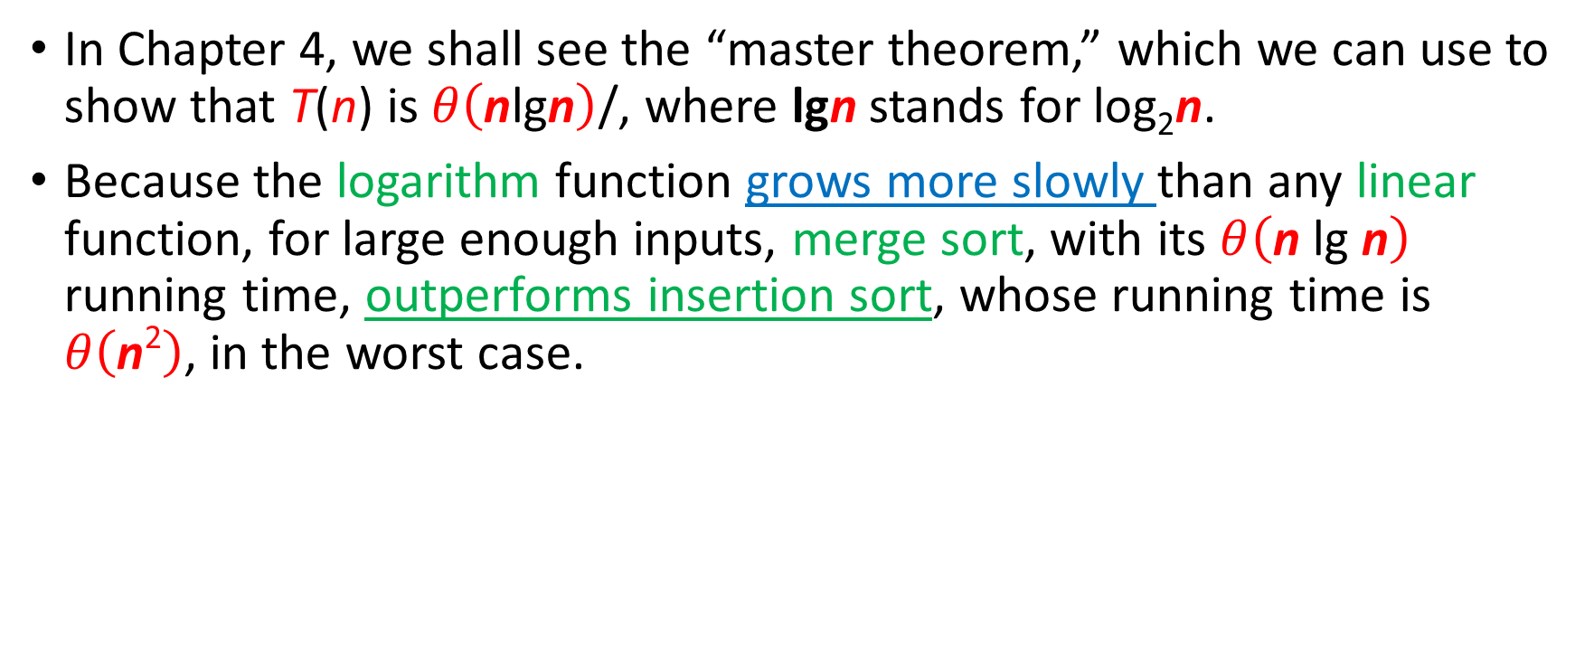
In Chapter 4, we shall see the “master theorem,” which we can use to show that T(n) is $θ\left(\text{n}\text{lg}\text{n}\right)$/, where lgn stands for log₂n.
Because the logarithm function grows more slowly than any linear function, for large enough inputs, merge sort, with its $θ\left(\text{n} \text{lg} \text{n}\right)$ running time, outperforms insertion sort, whose running time is $θ\left(\text{n}\text{2}\right)$, in the worst case.

Slide 52
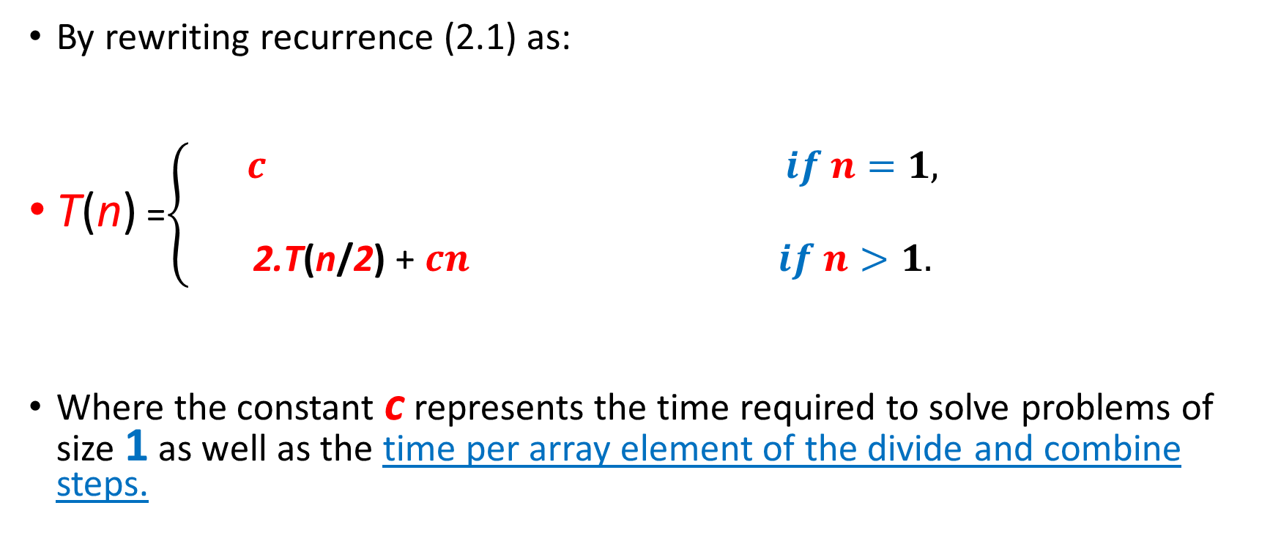
By rewriting recurrence (2.1) as:
T(n) =$\left\{\begin{aligned}c if n=1, \\ \\ \text{2.}\text{T}\text{(}\text{n}\text{/}\text{2}\text{)} \text{+} cn if n>1.\end{aligned}\right.$
Where the constant c represents the time required to solve problems of size 1 as well as the time per array element of the divide and combine steps.
(2.2)

Slide 53
For convenience, we assume that n is an exact power of 2.
The cn term is the root (the cost incurred at the top level of recursion), and the two subtrees of the root are the two smaller recurrences T(n/2).
The cost incurred at each of the two subnodes at the second level of recursion is cn/2.
We continue expanding each node in the tree by breaking it into its constituent parts as determined by the recurrence, until the problem sizes get down to 1, each with a cost of c.

Slide 54
Next, we add the costs across each level of the tree.
The top level has total cost cn, the next level down has total cost c.n/2 + c.n/2 = cn, the level after that has total cost: c.n/4 + c.n/4 + c.n/4 +c.n/4 = cn, and so on.
In general, the level i below the top has 2^{i} nodes, each contributing a cost of c.n/2^{i} , so that the i^{th} level below the top has total cost: 2^{i}.c.n/2^{i} = cn.
The bottom level has n nodes, each contributing a cost of c, for a total cost of cn.

Slide 56
The total number of levels of the recursion tree in the Figure is lgn + 1, where n is the number of leaves, corresponding to the input size.
The base case occurs when n = 1, in which case the tree has only one level.
Since lg1 = 0, we have that lgn + 1 gives the correct number of levels.
The number of levels of a recursion tree with 2^{i} leaves is: lg2^{i} + 1 = i + 1.
A tree with n = 2^{i+1} leaves has one more level than a tree with 2^{i} leaves, and so the total number of levels is: (i + 1) + 1 = lg2^{i+1} + 1.

Slide 57
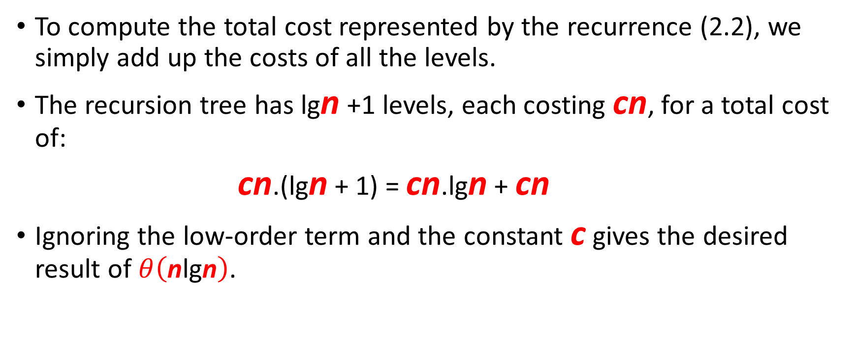
To compute the total cost represented by the recurrence (2.2), we simply add up the costs of all the levels.
The recursion tree has lgn +1 levels, each costing cn, for a total cost of:
cn.(lgn + 1) = cn.lgn + cn
Ignoring the low-order term and the constant c gives the desired result of $θ\left(\text{n}\text{lg}\text{n}\right)$.

